Slide 1
In order to play videos, click the Enable Content button above.
We Are Problem-Solvers!
Digital Lesson Bundle
Notes:
++++ENABLE CONTENT WARNING++++
In order to play videos, click the Enable Content button in the Security Warning popup.

Slide 2
What is Problem Solving?
The process of finding solutions that improve lives.
Time's Up!
0:01
0:02
0:03
0:04
0:05
0:06
0:07
0:08
0:09
0:10
0:11
0:12
0:13
0:14
0:15
0:16
0:17
0:18
0:19
0:21
0:22
0:23
0:24
0:26
0:27
0:28
0:29
0:30
30 Sec
Start Timer
0:20
0:25
Notes:
Instructor Notes:
As you distribute a sticky note to each student, direct students’ attention to the question at the top of the slide: “What is problem-solving?”
Click to display the “snowball toss” screen. Tell them that when you say “go,” you will start the 30-second timer. They will have 30 seconds to write their answers to the question on their sticky notes, crumple them up, and throw them toward you in the front of the room.
Click to start the timer.
When the timer sounds, collect the “snowballs” and tell students that you are going to try to find a response that does not include the words “solve” or “problems.” Read any you find.
Click to reveal the definition of problem-solving and read it aloud.

Slide 3
How Do We Solve Problems?
ASK to identify the need & constraints
RESEARCH the problem
IMAGINE possible solutions
PLAN by selecting a promising solution
CREATE a prototype
TEST & evaluate the prototype
IMPROVE & redesign as needed
EASY ANSWER → The same way engineers do!
The engineering design process can be used as a road map for solving most problems and challenges.
ENGINEERING DESIGN PROCESS
Notes:
Instructor Notes:
Guide students through the steps of the engineering design process and emphasize its usefulness in solving problems and challenges of all kinds. If students have worked through any of the Topic Series activities, this might be a review, and you can move quickly through the next four slides. If not, make sure students understand each step before progressing to the next slide.

Slide 4
Define the Problem
ASK to identify the need & constraints
RESEARCH the problem
IMAGINE possible solutions
PLAN by selecting a promising solution
CREATE a prototype
TEST & evaluate the prototype
IMPROVE & redesign as needed
Identify the problem by asking questions and confirming any constraints, or limitations of time, money, or resources.
Include all stakeholders.
Research causes, effects, existing solutions, etc.
Identify fact from opinion.
ENGINEERING DESIGN PROCESS
Notes:
Instructor Notes:
The first step of the problem-solving process is to define the problem. Help the students make the connection that this directly relates to the “Ask” and “Research” steps in the engineering design process. Read or ask volunteers to read what is involved in defining a problem.
Make sure students understand that to define an actual problem, they may need to figure out what the root problem is. It may be helpful to use the metaphor of treating symptoms (fever, cough, etc.) rather than figuring out and treating the disease that is causing them.
Also, part of defining the problem is acknowledging and defining the constraints. Constraints are limitations on the solution or design, such as available materials, funds, or time.
Emphasize that students should include all stakeholders to make sure that everyone’s unique needs are being met.

Slide 5
Ideate Solutions
ASK to identify the need & constraints
RESEARCH the problem
IMAGINE possible solutions
PLAN by selecting a promising solution
CREATE a prototype
TEST & evaluate the prototype
IMPROVE & redesign as needed
List ideas and solutions that have already been suggested/used.
Generate new ideas for ways to solve the problem.
Brainstorm, keeping constraints in mind.
ENGINEERING DESIGN PROCESS
Notes:
Instructor Notes:
The second step of the problem-solving process is to ideate, or imagine, solutions. First, define the word “ideate” if students are unfamiliar with the term: form ideas
Read or ask new volunteers to read what is involved in ideating a solution.
Make sure students understand that they should reserve judgement or try not to evaluate any of the ideas that come up during brainstorming. All ideas should be listed or considered as they can form a springboard to the idea that solves a problem!
Emphasize that while strong partnerships and forming good teams is important throughout the engineering design process, having diverse members who think about things in creative ways can be especially beneficial in this step!
And remind them that they should always consider their constraints throughout every stop of the process!

Slide 6
Design
ASK to identify the need & constraints
RESEARCH the problem
IMAGINE possible solutions
PLAN by selecting a promising solution
CREATE a prototype
TEST & evaluate the prototype
IMPROVE & redesign as needed
Discuss ideas and select a solution.
Create a prototype that fits your solution: Blueprint, model, written instructions, etc.
Attempt to implement solution as designed.
ENGINEERING DESIGN PROCESS
Notes:
Instructor Notes:
The third step of the problem-solving process is to design (and possibly build) a solution to the problem. Emphasize to students how this mimics the detailed steps of the engineering design process.
Explain to students that as a team, they must think through their brainstorming list and select the solution most relevant to their problem, most likely to be effective, and most likely to address the needs of all stakeholders. It is also important to consider which they would be most able to implement successfully.
Read or ask new volunteers to read what is involved in planning, creating, and testing a solution. Discuss how different solutions require different steps (i.e., a machine might require a blueprint or model, but a letter-writing campaign might require a detailed set of instructions.)

Slide 7
Evaluate
ASK to identify the need & constraints
RESEARCH the problem
IMAGINE possible solutions
PLAN by selecting a promising solution
CREATE a prototype
TEST & evaluate the prototype
IMPROVE & redesign as needed
Evaluate effectiveness of solution.
List successes and areas for improvement.
Confirm that you have adhered to all constraints.
Seek out constructive feedback.
Determine if changes need to be made or alternative solutions should be explored.
ENGINEERING DESIGN PROCESS
Notes:
Instructor Notes:
The final step in the problem-solving process is to evaluate the solution that was implemented. In the engineering design process, this overlaps with the Test phase and includes the Improve phase.
Read or ask new volunteers to read the steps in evaluating a design.
Remind students that failing is part of moving forward, and not every design or solution will always be successful. Define for students the phrase “iterative process.” (It is the process of building, refining, and improving on designs.) Emphasize that the engineering design process is often represented as a circle because, during this stage, many engineers start again in order to improve their initial design.

Slide 8
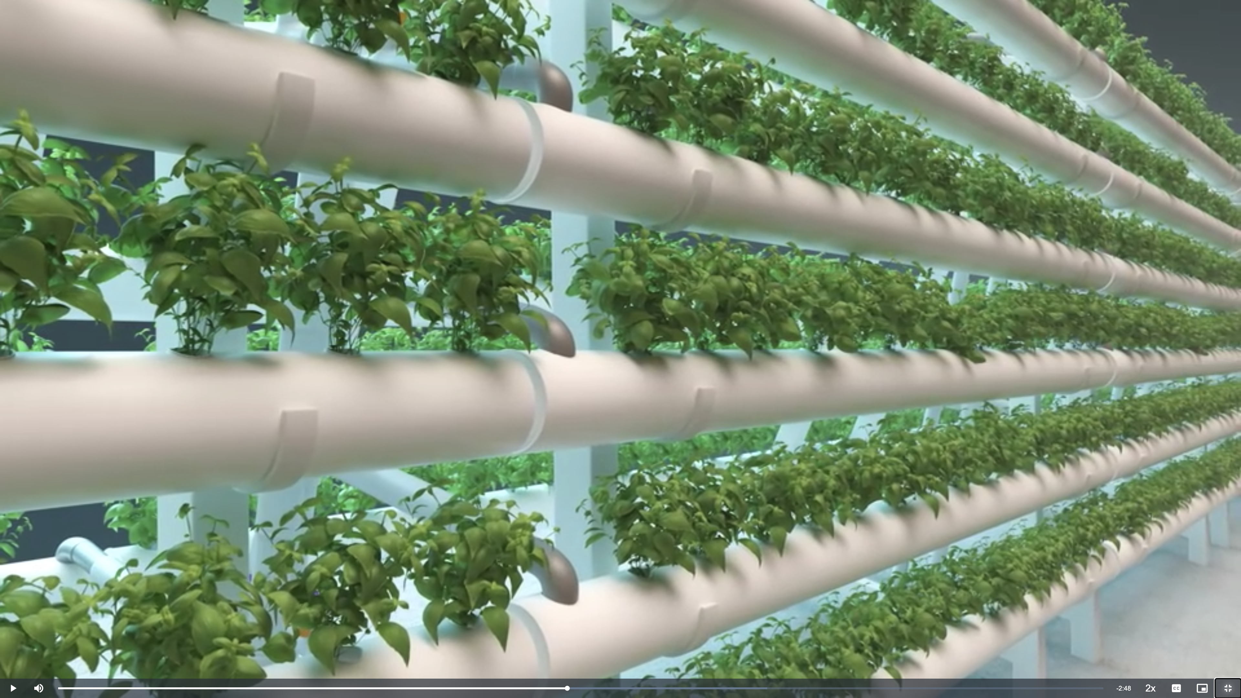
Big Problem-Solvers
Notes:
Instructor Notes:
Explain to students that they will be watching three short videos about real people who solved big problems. Emphasize that each problem was very serious within its community, but could also have had a large impact globally.
Distribute one Big Problem-Solvers Guided Notes handout to each student. Quickly review the handout and instruct students to take notes as they watch each video. If time allows, provide some time after each video for students to add to their notes

Slide 9
Building the Road to Cleaner Water
In order to play videos, click the Enable Content button above.
Notes:
Instructor Notes:
Explain to students that empathy—the ability to understand and share the feelings of others—is an important aspect to solving problems and challenges. Ask them to imagine for a moment what life would feel like without immediate access to clean water. Would they feel safe? How would their daily life be impacted? Where do they think they would get water from if not from their sinks?
Explain to students that of the 7.9 billion people on our planet, 2.2 billion people still lack access to safe drinking water.* In the first video, students will learn about Caminos de Agua—an organization that aims to improve human health and community well-being through adequate and affordable access to clean water.
Remind students to take notes as they watch the video.
Click to begin the video.
If video does not play, be sure to exit presentation mode click the Enable Content button.
If time allows, provide some time after the video for students to add to their notes.
*https://sdgs.un.org/goals/goal6

Slide 10
Solar Power Up!
In order to play videos, click the Enable Content button above.
Notes:
Instructor Notes:
Ask students if they have ever taken time to think about what fuels their cooking appliances? Can they imagine how their daily lives would change if they had to go outside and cut wood every day in order to eat? What about the impact their cooking has on the environment?
Explain to students that in places around the world like the Indian Himalayas, the devastating effects of things like deforestation and climate change affect even simple aspects of human life, like cooking and staying warm. Products like the Himalayan Rocket Stove offer a way to cook food and produce heat that requires 50% less wood as fuel, and reduces the amount of work, while also creating a significant reduction in air pollution.
Remind students to take notes as they watch the video
Click to begin the video.
If video does not play, be sure to exit presentation mode click the Enable Content button.
If time allows, provide some time after the video for students to add to their notes.

Slide 11
Soilless Farming
In order to play videos, click the Enable Content button above.
Notes:
Instructor Notes:
Explain to students that in many countries around the world, farming is the largest source of pollution, because it often produces excess food waste, and toxins used in traditional agriculture can harm water, air, soil, and ecosystems. Solutions like close-looped and soilless (hydroponic) farming aim to solve the problem.
New forms of farming like hydroponics can also have dramatic effects on the health and well-being of those living in cities with little access to fresh produce and nutritious food choices, known as “food deserts.”
Remind students to take notes as they watch the video.
Click to begin the video.
If video does not play, be sure to exit presentation mode click the Enable Content button.
If time allows, provide some time after the video for students to add to their notes.

Slide 12
Let’s Reflect
ASK to identify the need & constraints
RESEARCH the problem
IMAGINE possible solutions
PLAN by selecting a promising solution
CREATE a prototype
TEST & evaluate the prototype
IMPROVE & redesign as needed
ENGINEERING DESIGN PROCESS
Notes:
Instructor Notes:
As time allows, let students to share some of their key takeaways from the videos and their notes.
Tell students that in the next session, they will take on the role of problem-solvers!

Slide 13
Be a Problem-Solver! (and an Engineer!)
ASK to identify the need & constraints
RESEARCH the problem
IMAGINE possible solutions
PLAN by selecting a promising solution
CREATE a prototype
TEST & evaluate the prototype
IMPROVE & redesign as needed
Define (ask, research)
Ideate (imagine)
Design (plan, create, test)
Evaluate (test, improve)
ENGINEERING DESIGN PROCESS
Notes:
Instructor Notes:
Begin the session by reinforcing what students learned about the problem-solving process in the previous session. Make sure to emphasize how the connection to the engineering design process can help solve most problems and challenges.
Briefly summarize each problem and its corresponding solution from the three videos.
Explain to students that in today’s session, they will be the problem-solvers as they work through the process to find a solution for a problem facing their local community
Distribute one Be a Problem-Solver! handout to each student and enough devices with internet access for each student or group, depending on your preference.

Slide 14
Define a Problem or Challenge in Your Community
ASK to identify the need & constraints
RESEARCH the problem
IMAGINE possible solutions
PLAN by selecting a promising solution
CREATE a prototype
TEST & evaluate the prototype
IMPROVE & redesign as needed
Identify the problem or challenge and any constraints to which you must adhere.
Research the problem or challenge.
Identify any solutions that have been suggested or attempted already.
ENGINEERING DESIGN PROCESS
Notes:
Instructor Notes:
Guide students’ attention to the DEFINE section of their handouts. The first step in the problem-solving process is for them to define a problem that they see in their local community. It can be big or small, affecting families or businesses, be at school or home, etc.
Using the engineering design process, they should identify the stakeholders and their needs, identify any constraints, and research the problem and suggested solutions thoroughly.
When it is time for students to research, you may choose to give them acceptable search engines or search engine terms or allow them to research on their own. Their goal is to find information about the problem and any solutions that might have been suggested or attempted.
Provide students with approximately 10 minutes to conduct brief research on their topic.

Slide 15
Ideate or Imagine Solutions
ASK to identify the need & constraints
RESEARCH the problem
IMAGINE possible solutions
PLAN by selecting a promising solution
CREATE a prototype
TEST & evaluate the prototype
IMPROVE & redesign as needed
Time's Up!
0:01
0:02
0:03
0:04
0:05
0:06
0:07
0:08
0:09
0:10
0:11
0:12
0:13
0:14
0:15
0:16
0:17
0:18
0:19
0:20
0:21
0:22
0:23
0:24
0:25
0:26
0:27
0:28
0:29
0:30
0:31
0:32
0:33
0:34
0:35
0:36
0:37
0:38
0:39
0:40
0:41
0:42
0:43
0:44
0:45
0:46
0:47
0:48
0:49
0:50
0:51
0:52
0:53
0:54
0:55
0:56
0:57
0:58
0:59
1:00
1:01
1:02
1:03
1:04
1:05
1:06
1:07
1:08
1:09
1:10
1:11
1:12
1:13
1:14
1:15
1:16
1:17
1:18
1:19
1:20
1:21
1:22
1:23
1:24
1:25
1:26
1:27
1:28
1:29
1:30
1:31
1:32
1:33
1:34
1:35
1:36
1:37
1:38
1:39
1:40
1:41
1:42
1:43
1:44
1:45
1:46
1:47
1:48
1:49
1:50
1:51
1:52
1:53
1:54
1:55
1:56
1:57
1:58
1:59
2:00
2:01
2:02
2:03
2:04
2:05
2:06
2:07
2:08
2:09
2:10
2:11
2:12
2:13
2:14
2:15
2:16
2:17
2:18
2:19
2:20
2:21
2:22
2:23
2:24
2:25
2:26
2:27
2:28
2:29
2:30
2:31
2:32
2:33
2:34
2:35
2:36
2:37
2:38
2:39
2:40
2:41
2:42
2:43
2:44
2:45
2:46
2:47
2:48
2:49
2:50
2:51
2:52
2:53
2:54
2:55
2:56
2:57
2:58
2:59
3:00
3 Min
Start Timer
ENGINEERING DESIGN PROCESS
Notes:
Instructor Notes:
After students research their community-based problem, they need to ideate potential solutions. Encourage them to use previously attempted solutions as springboards for their brainstorming if relevant.
Remind students of the importance of building diverse problem-solving teams with creative and unique ways of thinking. All team members and ideas should be valued and recorded.
Tell them you are going to give them three minutes to list as many ideas as they can that might solve the problem. Remind them to record all ideas on their handouts without any evaluation or judgment.
Click to start the three-minute timer.

Slide 16
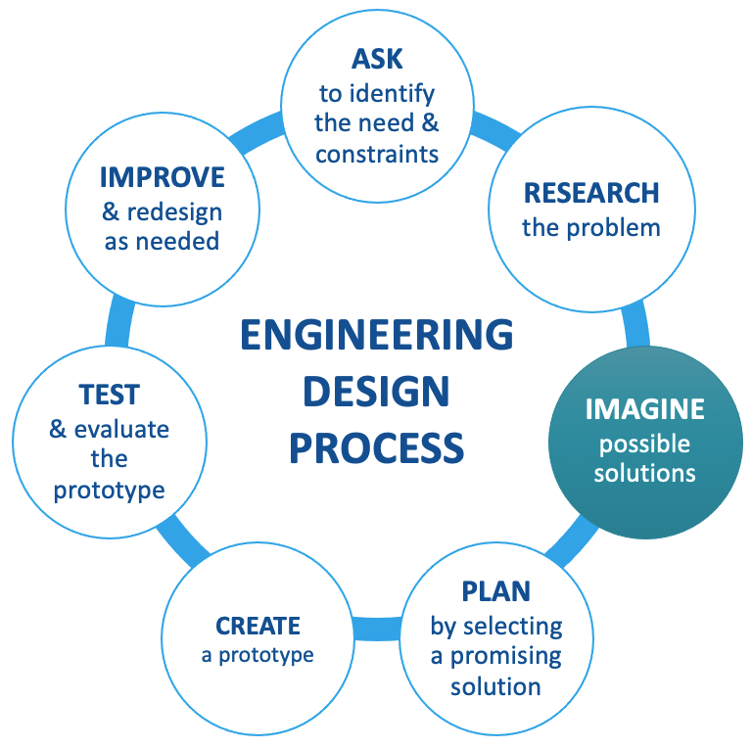
Design a Community Solution
Select a solution from the brainstorming bubble.
Decide on a design process.
Make a plan to create the solution and then implement or test it as designed.
Time's Up!
0:01
0:02
0:03
0:04
0:05
0:06
0:07
0:08
0:09
0:10
0:11
0:12
0:13
0:14
0:15
0:16
0:17
0:18
0:19
0:20
0:21
0:22
0:23
0:24
0:25
0:26
0:27
0:28
0:29
0:30
0:31
0:32
0:33
0:34
0:35
0:36
0:37
0:38
0:39
0:40
0:41
0:42
0:43
0:44
0:45
0:46
0:47
0:48
0:49
0:50
0:51
0:52
0:53
0:54
0:55
0:56
0:57
0:58
0:59
1:00
1:01
1:02
1:03
1:04
1:05
1:06
1:07
1:08
1:09
1:10
1:11
1:12
1:13
1:14
1:15
1:16
1:17
1:18
1:19
1:20
1:21
1:22
1:23
1:24
1:25
1:26
1:27
1:28
1:29
1:30
1:31
1:32
1:33
1:34
1:35
1:36
1:37
1:38
1:39
1:40
1:41
1:42
1:43
1:44
1:45
1:46
1:47
1:48
1:49
1:50
1:51
1:52
1:53
1:54
1:55
1:56
1:57
1:58
1:59
2:00
2:01
2:02
2:03
2:04
2:05
2:06
2:07
2:08
2:09
2:10
2:11
2:12
2:13
2:14
2:15
2:16
2:17
2:18
2:19
2:20
2:21
2:22
2:23
2:24
2:25
2:26
2:27
2:28
2:29
2:30
2:31
2:32
2:33
2:34
2:35
2:36
2:37
2:38
2:39
2:40
2:41
2:42
2:43
2:44
2:45
2:46
2:47
2:48
2:49
2:50
2:51
2:52
2:53
2:54
2:55
2:56
2:57
2:58
2:59
3:00
3 Min
Start Timer
Notes:
Instructor Notes:
Tell students that you are now going to give them three minutes to go through the ideas in their brainstorming bubble and quickly judge and evaluate each one until they decide on a solution with which to move forward. Remind them to consider what has been successful or not in the past and what is most likely to be achievable and successful in the future. They should also consider what will address the concerns of all the stakeholders while remaining within the parameters of any constraints.
Click to start the three-minute timer.
When the timer sounds, remind students that each solution requires a different design process or prototype. Will theirs require a blueprint, a model, detailed instructions, etc.?
Direct students’ attention to the DESIGN section of their handouts. They should record their chosen solution and details of their design process, including any drawings or notes needed, as well as how they plan to implement or test this solution once it is fully designed (and built if necessary).

Slide 17
Plan to Evaluate and Improve
ASK to identify the need & constraints
RESEARCH the problem
IMAGINE possible solutions
PLAN by selecting a promising solution
CREATE a prototype
TEST & evaluate the prototype
IMPROVE & redesign as needed
How will you test and evaluate the effectiveness of your solution?
How will you seek out constructive feedback?
What will you do with the feedback?
Will you improve and redesign your solution?
ENGINEERING DESIGN PROCESS
Notes:
Instructor Notes:
Remind students that once they implement their designed solution, they will have to test and evaluate its effectiveness. Therefore, it is wise for them to think ahead and create a plan.
Direct students’ attention to the EVALUATE page of their handouts. Give them time to think through the questions on the slide and create a plan to test and evaluate their design.
Remind students of the importance of the iterative process and finding ways to make their designs even better. Are they willing to improve and redesign their designs in order to solve the problem?

Slide 18
We Are Problem-Solvers!
Notes:
Instructor Notes:
Congratulate students on working through the problem-solving process and the engineering design process to design a solution to a problem or challenge in their local community!
Remind them that they have learned the tools to apply to any new problems they may encounter in the future, just like engineers!

